Slide 1

ONLINE BUS TRACKING AND BOOKING APPLICATION
GROUP A26

Slide 2
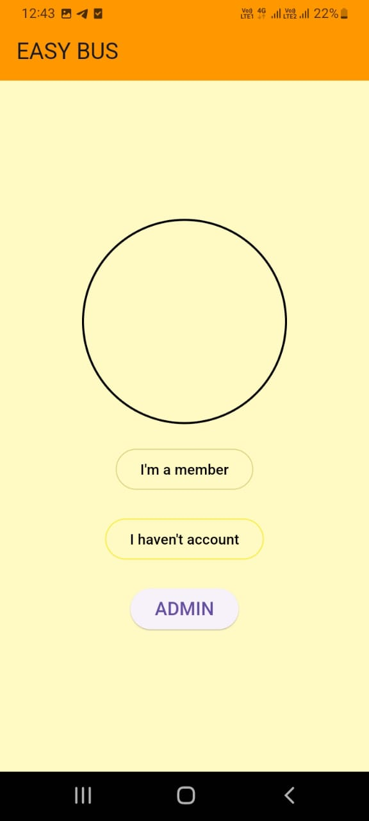
INTRODUCTION
Seamless Online Booking
Real-Time Tracking
Hassle-Free Travel
Efficient Journey Planning
Future of Transportation

Slide 3
WORK PLANNING
Planning Phase
Design Phase
Development Phase
Testing Phase
Deployment Phase
Maintenance and Support Phase

Slide 4
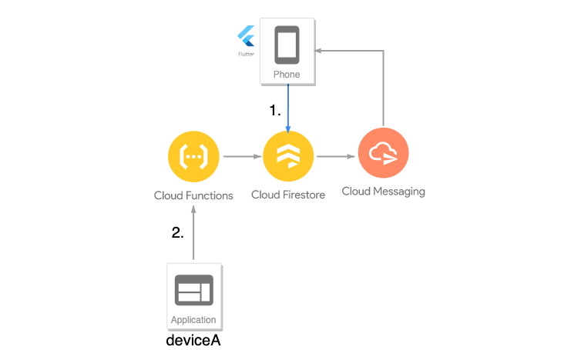
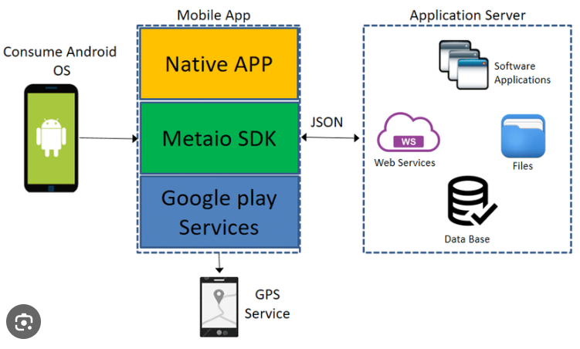
Project Architecture

Slide 5
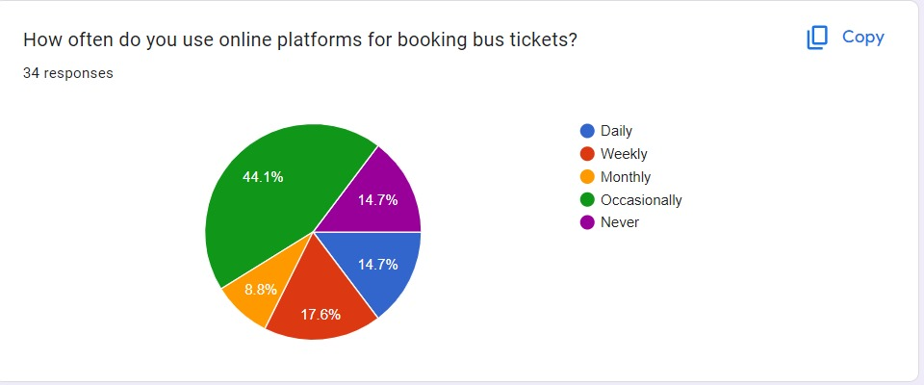
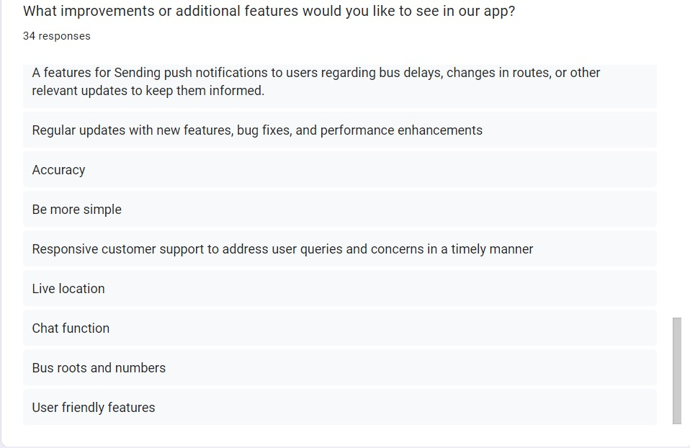
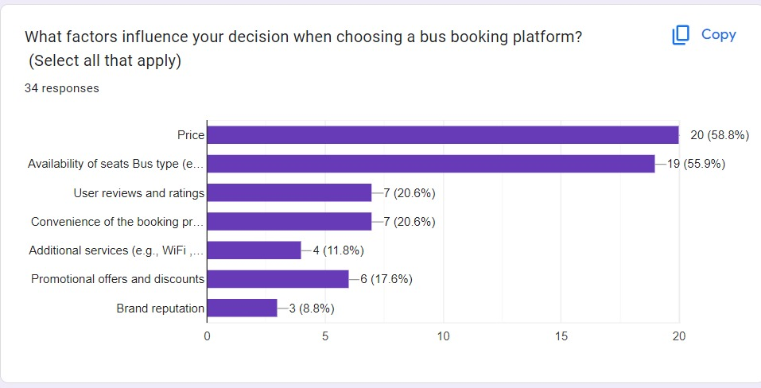
RESEARCH
We've researched industry trends and market growth.
Explored user behaviors in bus booking.
Assessed key competitor strengths and weaknesses.
Identified necessary tech infrastructure.
5Used feedback to shape app development.

Slide 6


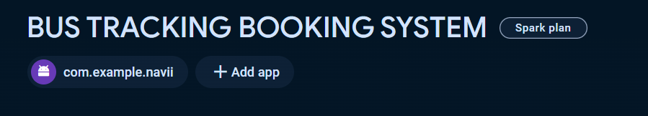
Project Starting
Dynamic Fusion
Expressive UI
Real-time Functionality
Scalability and Reliability
Revolutionizing App Development

Slide 7
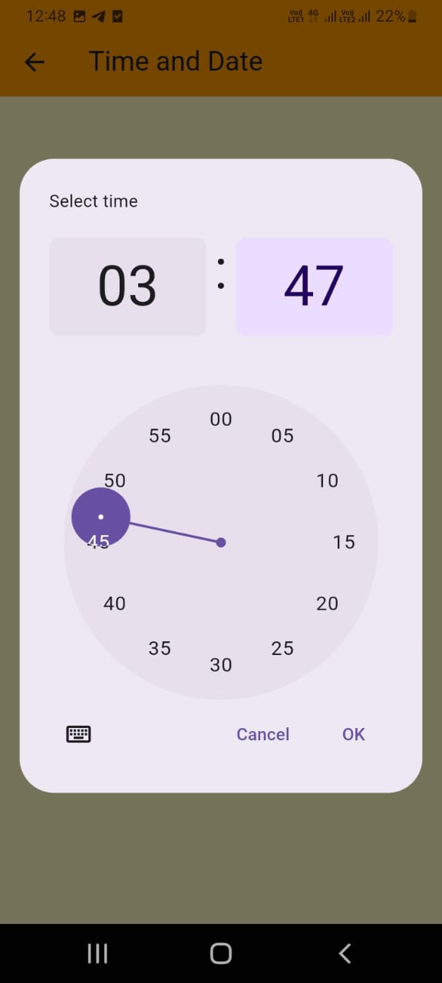
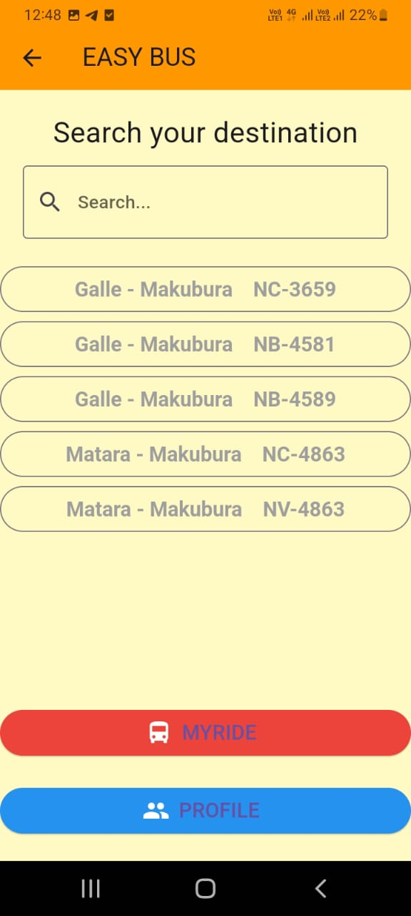
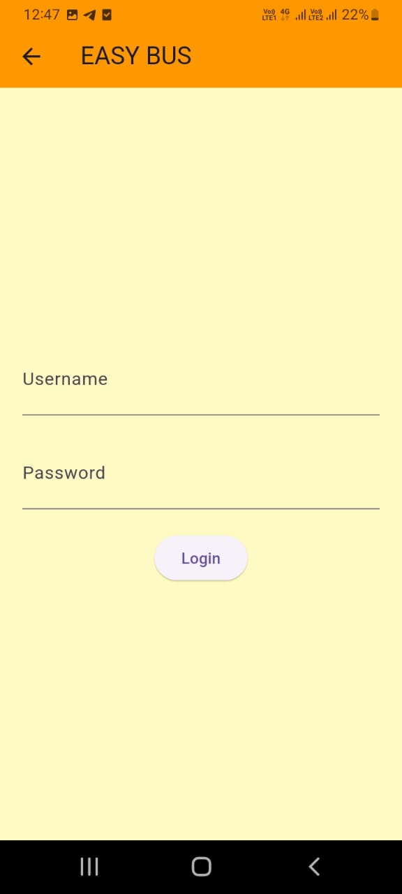
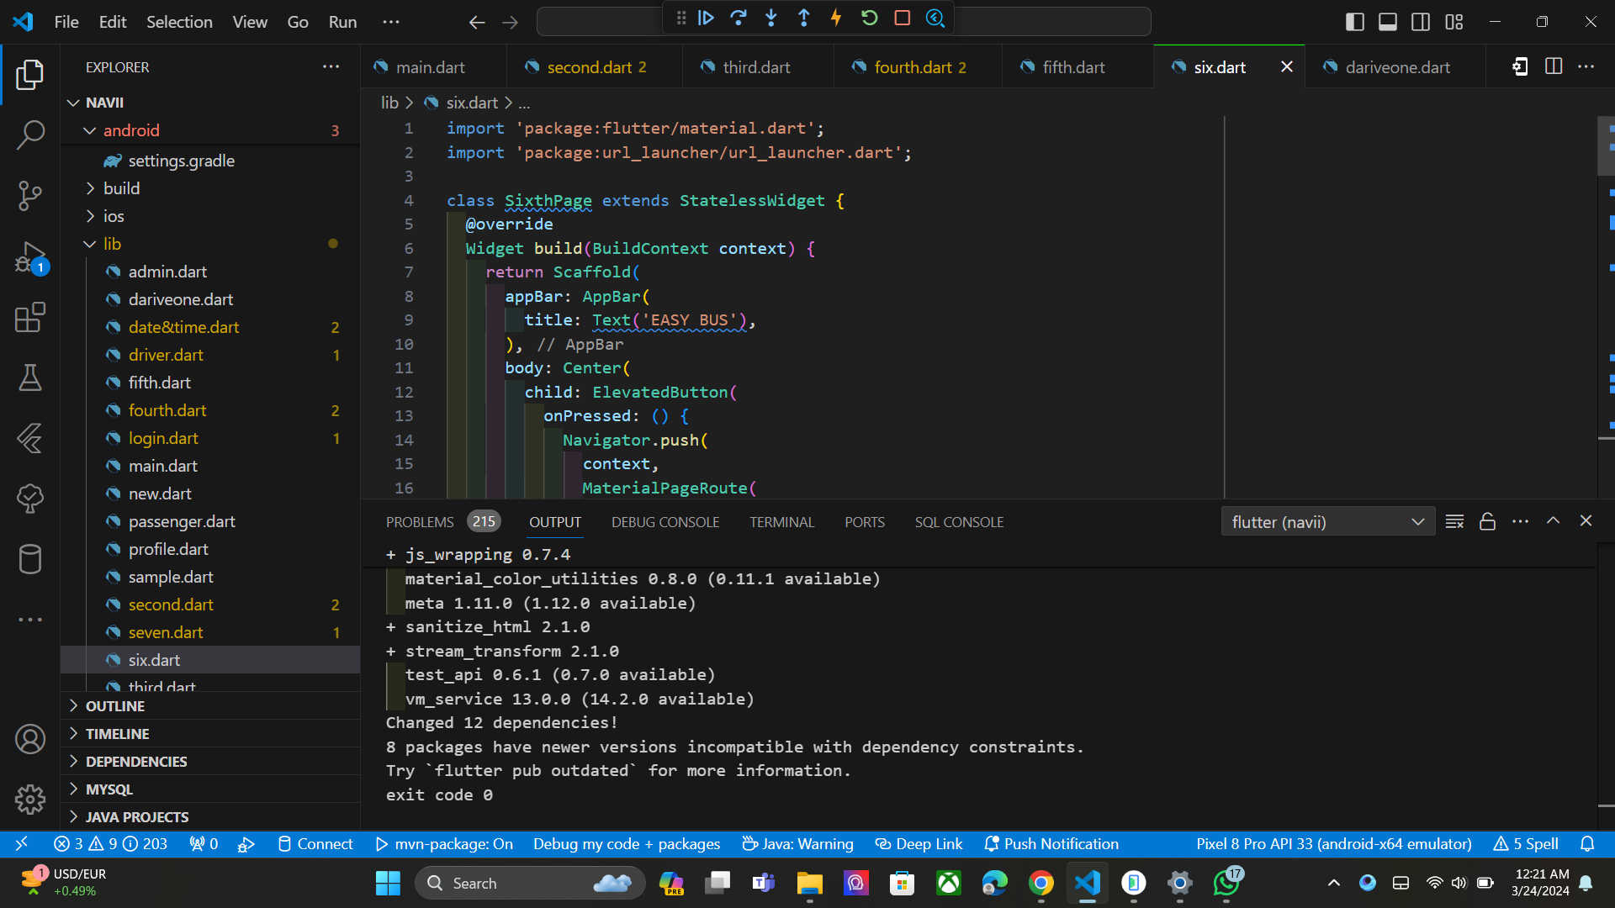
FRONT-END DEVELOPING CONTINUING

Slide 8
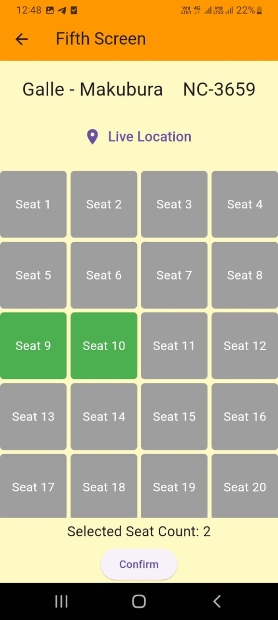
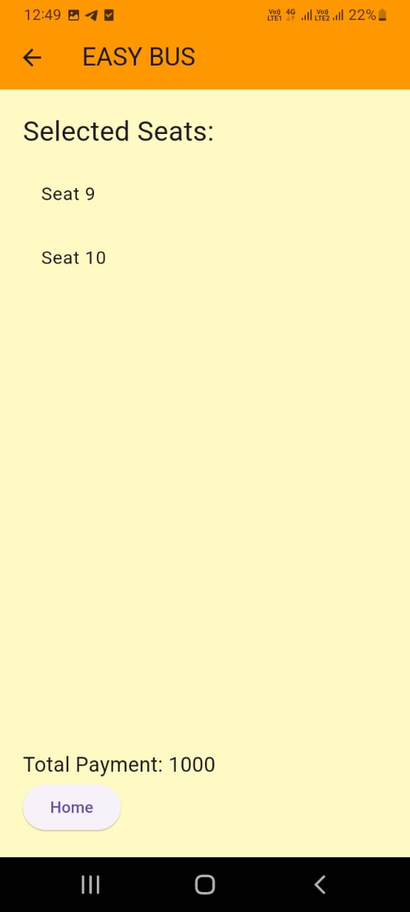
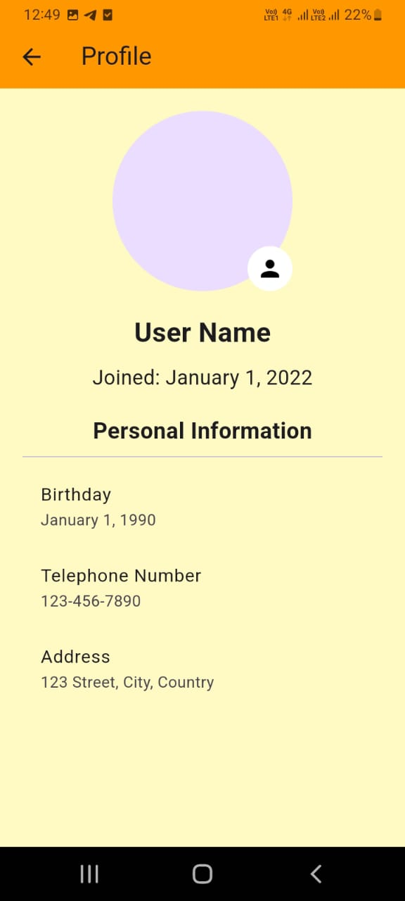

Slide 9

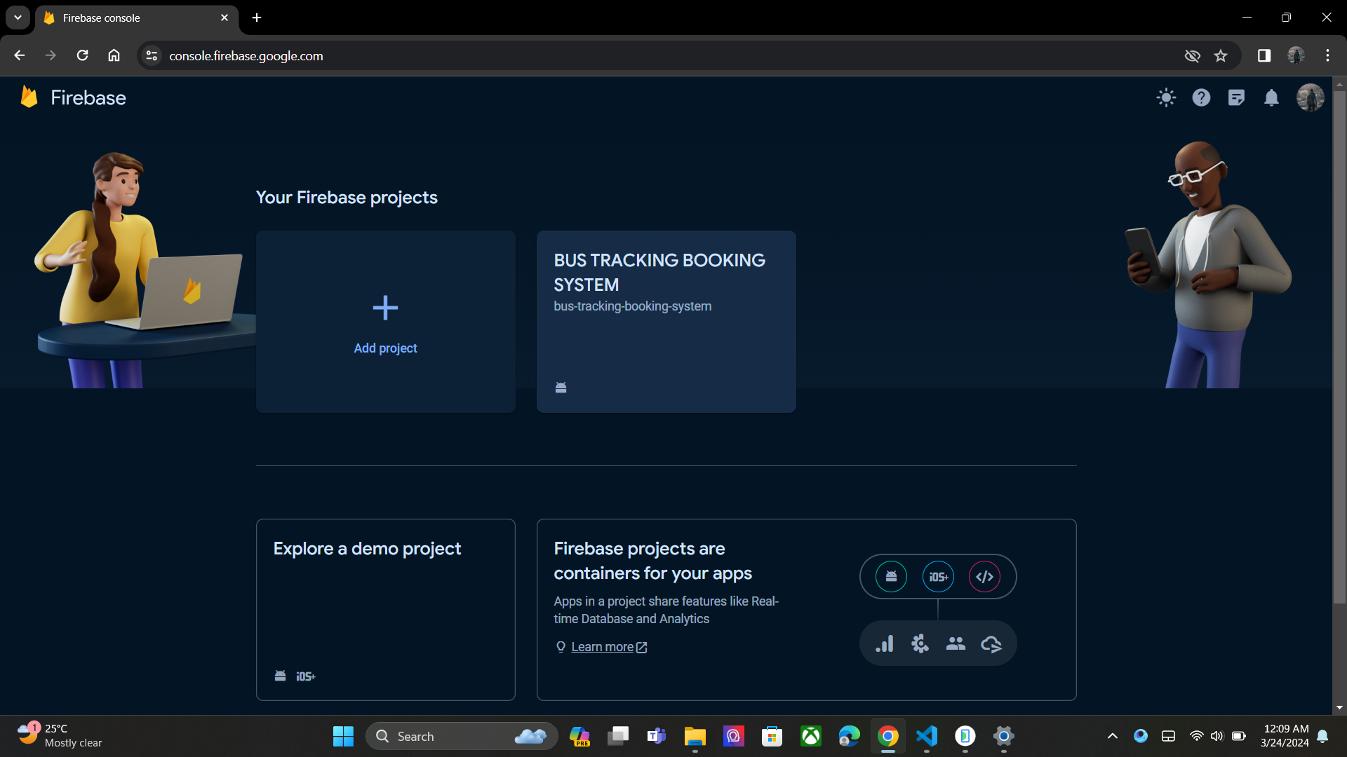
DATABASE WITH FIREBASE
Real-Time Updates
Scalability
Structured Data
Offline Support
Security Rules

Slide 10
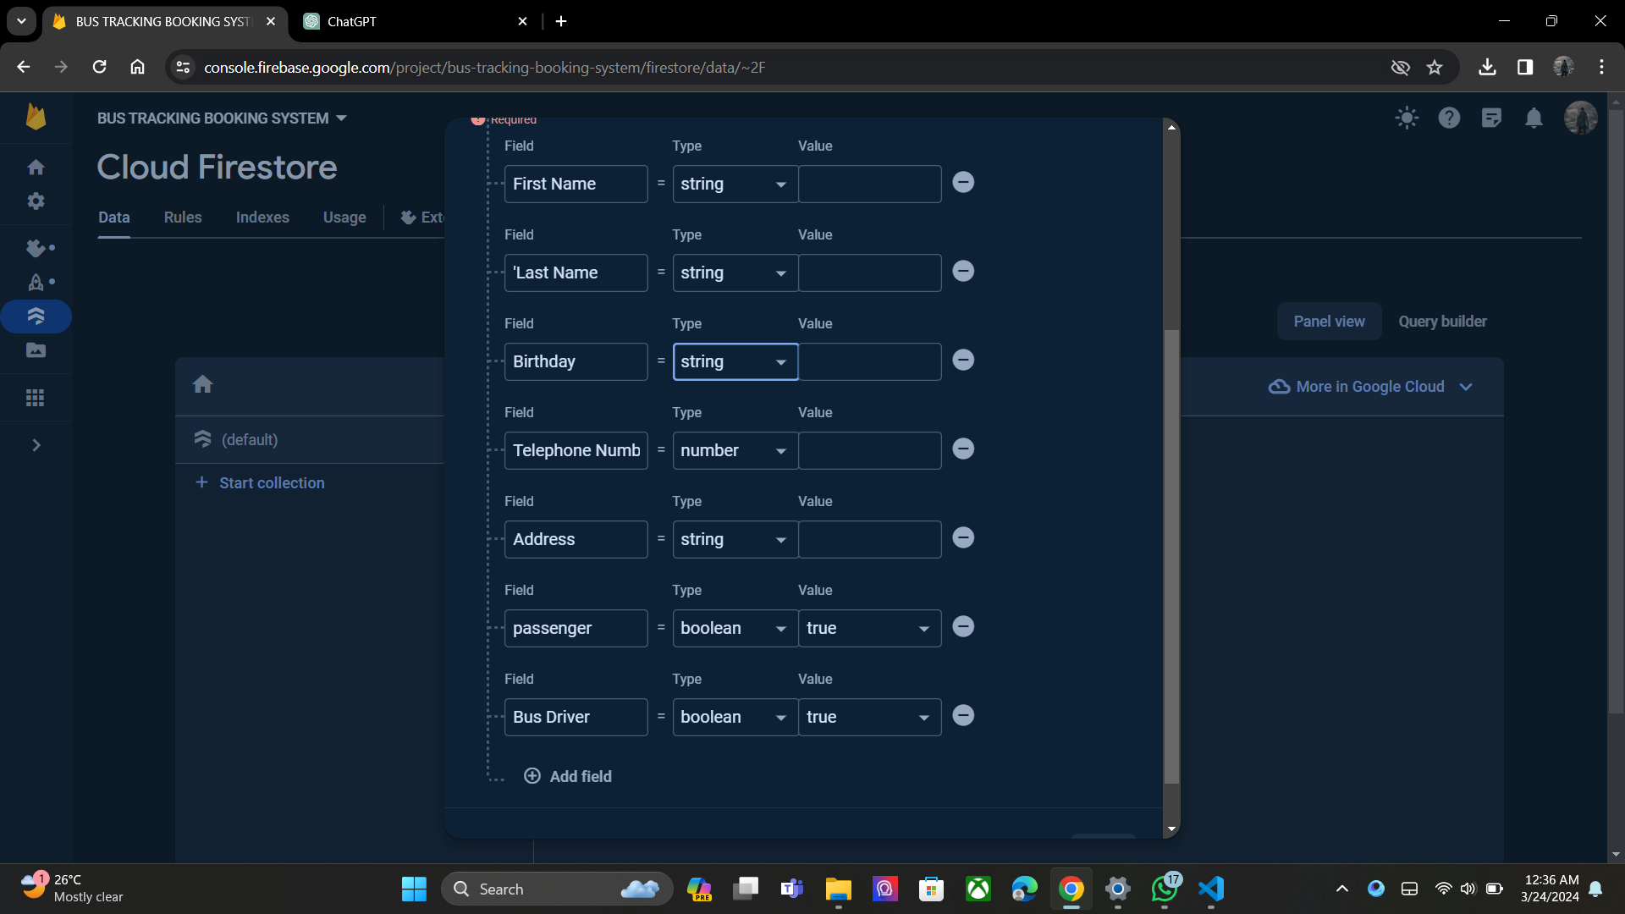
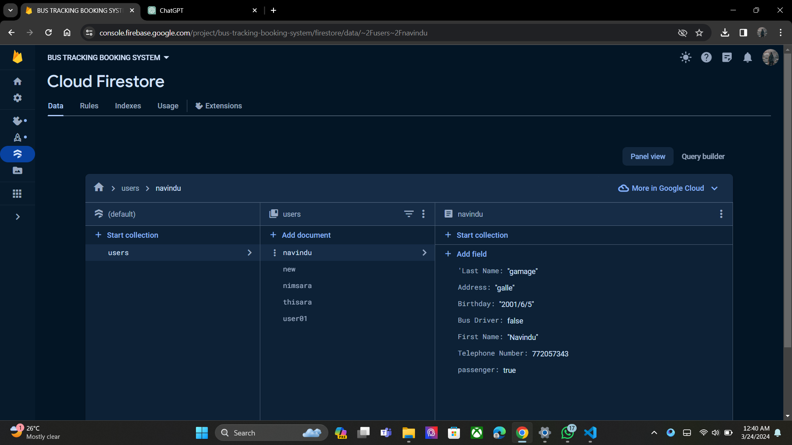
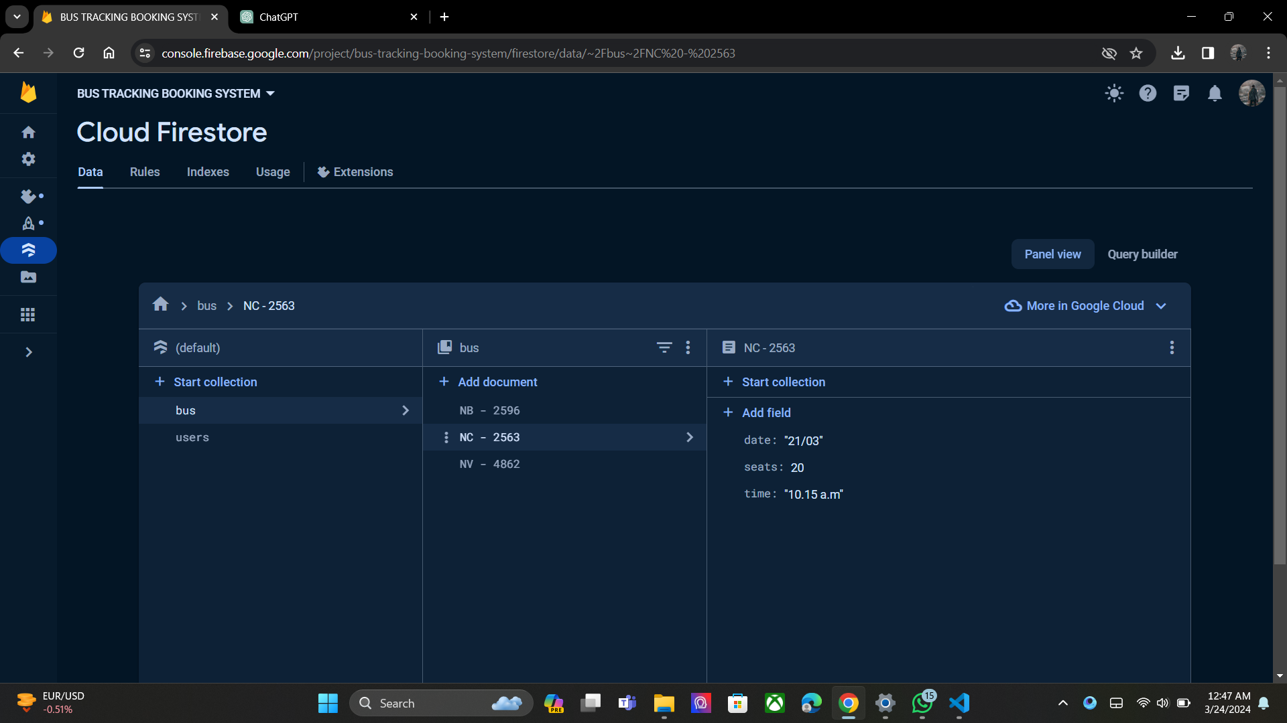
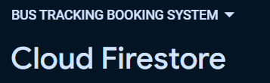

Slide 11
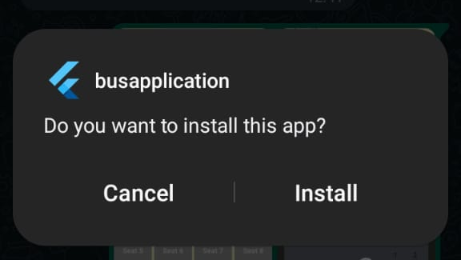
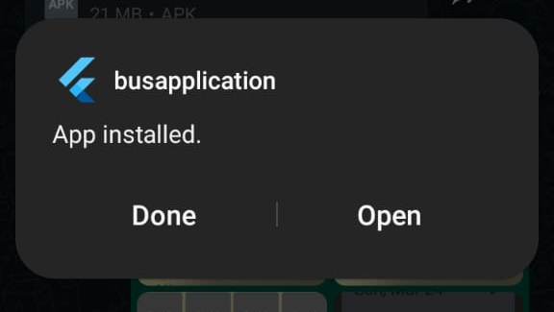
APPLICATION RELEASE AND FEEDBACKS
Beta Testing
Feedback Channels
Analytics Monitoring
Iterative Updates
Engage with Users
BUS APPLICATION

Slide 12
UPDATE AND MAINTAINCE
Regular Updates
Bug Fixes
Feature Enhancements
Performance Optimization
Security Updates

Slide 13
THANK YOU
GROUP A26
10899521 – Navindu Nimsara Gamage
10899603 – Wedamulla Madinage Thisara Madusanka
10899621- Chathupraba Devindi Munasinghe
10899556- Yaddehi Kishal Sankalpa Jayalath
10899685- Kihaduwage Diduli Wijini Sahasra
10899600- Senanayake Dasili Liyanage Sameepa Pramuditha

